Slide 1

Bi project of Customer Churn Analysis
agenda
Business problem
Analysis/ results
Methodology
Discussion & proposed solution
Joseph Hasheley scheitzer

Slide 2
problem
the problems facing the company are
1 the unsubscribe rate is increasing more and more .
2 the services offered by the company do not relate to all customers
3 the considerable loss

Slide 3
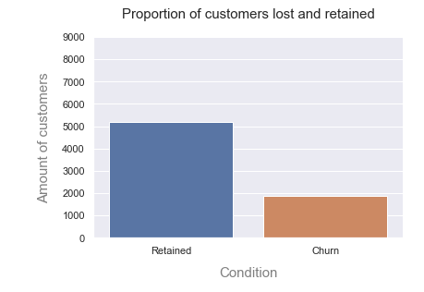
Results
73,46%
26,53%
the percentage of unsubscribers is equivalent to 26.53% or 1869 of the total number of customers which is 7043 subscribers

Slide 4
Results
the types of customers who churn are
the types of clients who unsubscribe are those who do not have a partner, since we find that 1,200 out of 1,869 clients who do not have a partner unsubscribed this month.
women with a rate of 50.24%.
We also note that customers who are not dependent on any person unsubscribe much more, a rate of 1543 out of 1869 or 82.87% of unsubscribers.
customers with telephone service: 90.90%
Those who use fiber optics as an internet service unsubscribe more than the others, a rate of 69.39%

Slide 5
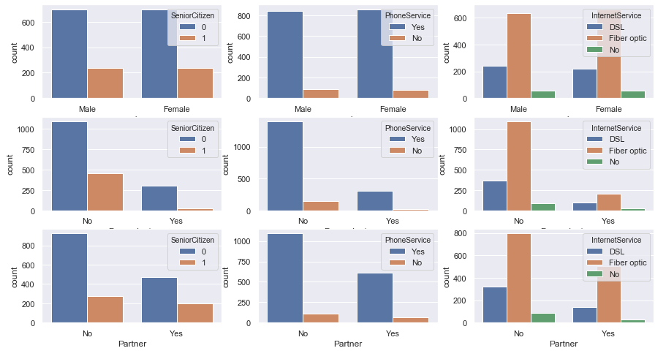
Results

Slide 6
Discussion & proposed solution
in the space of a month the telecommunication company made a fairly considerable loss, a loss of 139,130.85 on 456,116.6 which equates to a rate of 30.50%so to reduce this infernal rate of unsubscribers it is essential to increase the quality of some services compared to quick few customers
we will need to increase the DSL option for internet service for clients who do not have a partner and who are dependent, because we see that the optic fiber option is much more used by customers who unsubscribe most of the time
Case Study

Slide 7
References & appendices

